Slide 1
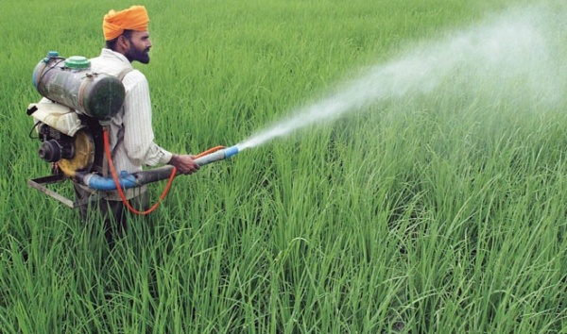
Smart agriculture
This Photo by Unknown Author is licensed under CC BY-SA-NC

Slide 2
Input Block
Input block takes the input from the user such as soil moisture content and pH level.
User gives the soil pH value and soil moisture level using python code

Slide 3
If
pH level is greater than 6.7
Then,
Alerts
Display the suite data in Node-red

Slide 4
If
Soil moisture lesser than 420
Alert
Pump will be turned on

Slide 5
Thank you………
Team : The alpha
G . Taruni
P . Vaishnavi
S . Triya
Ch . Sucharitha

